Slide 1
Diversity Patterns
Today’s Agenda:
Quiz
Diversity Pattern Examples
Measuring Diversity
Types of Diversity

Slide 2
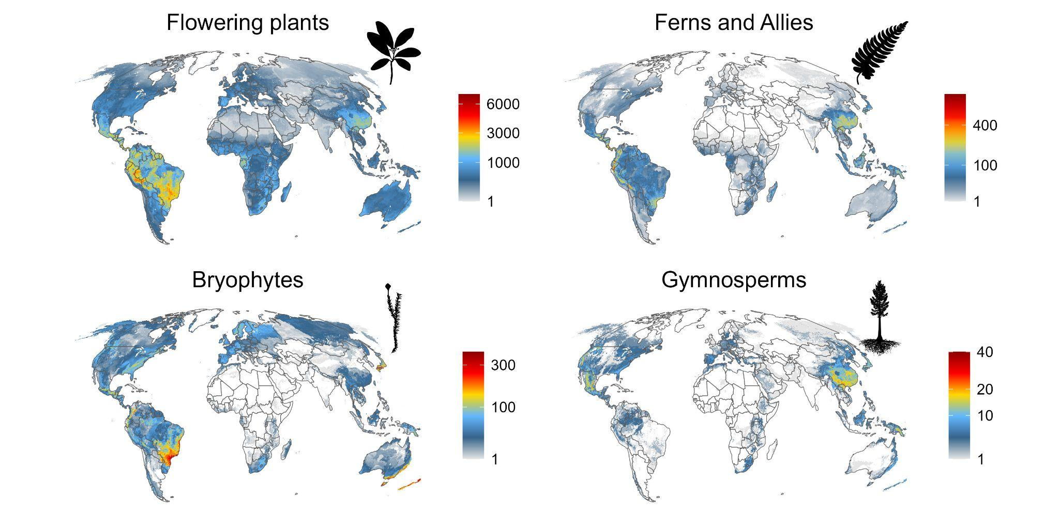
Species Richness: Plants
Enquist et al. (in prep)
Notes:
Bryophytes -> data quality issues

Slide 3
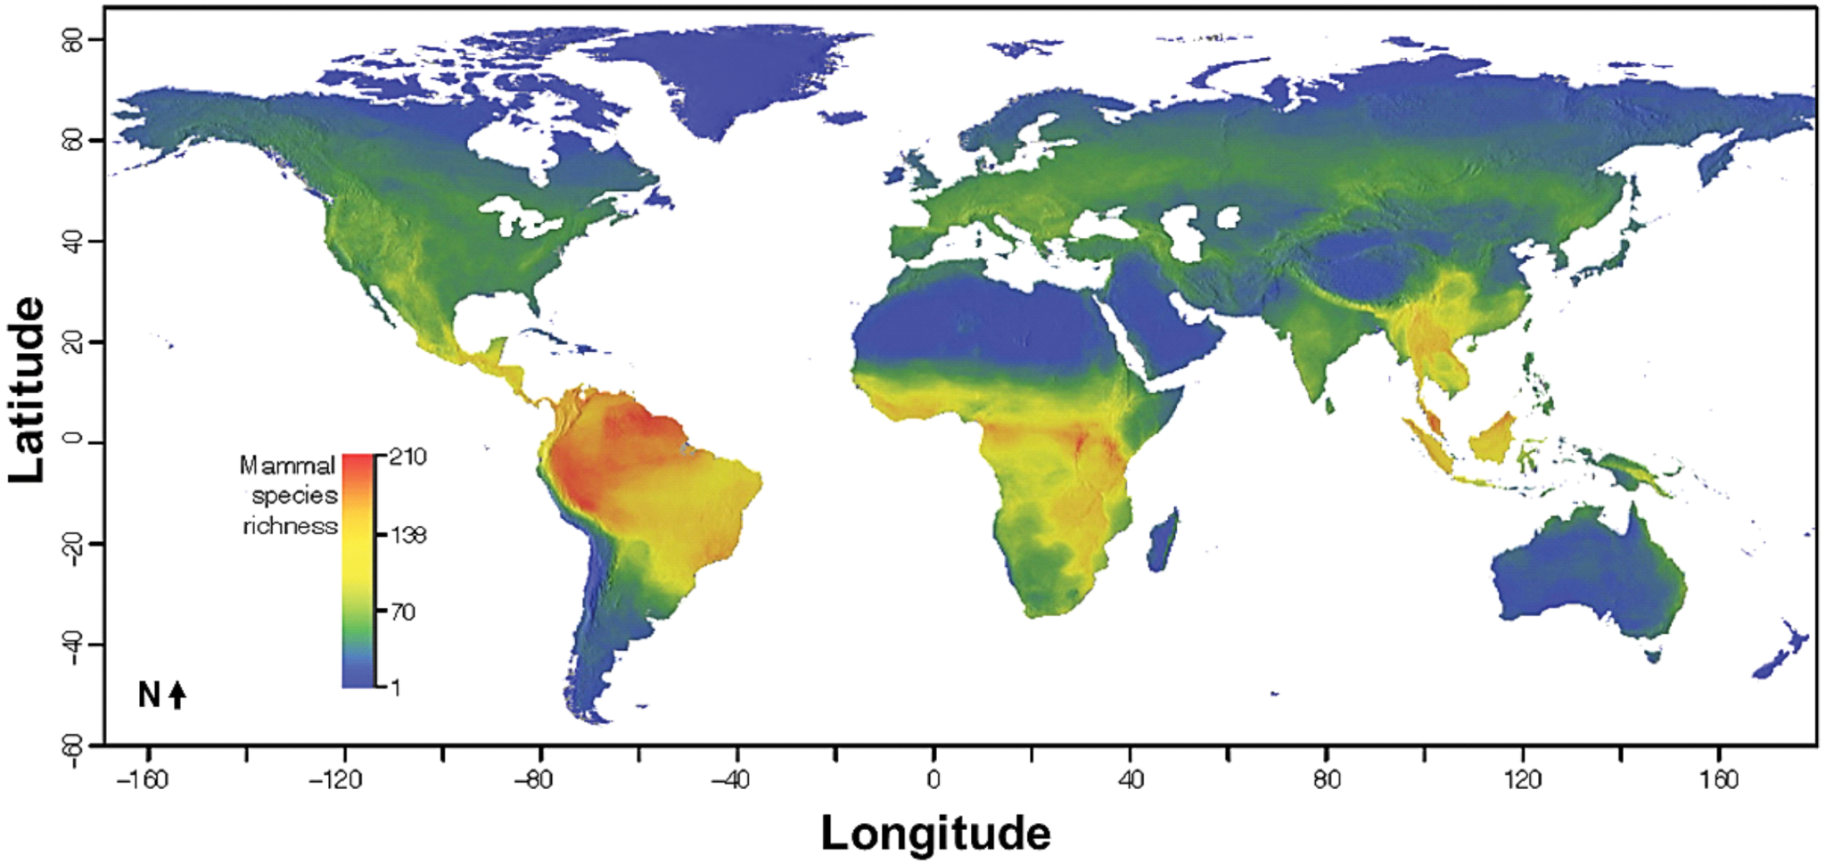
Species Richness: Mammals
Jenkins, C. N., S. L. Pimm, and L. N. Joppa. 2013.

Slide 4
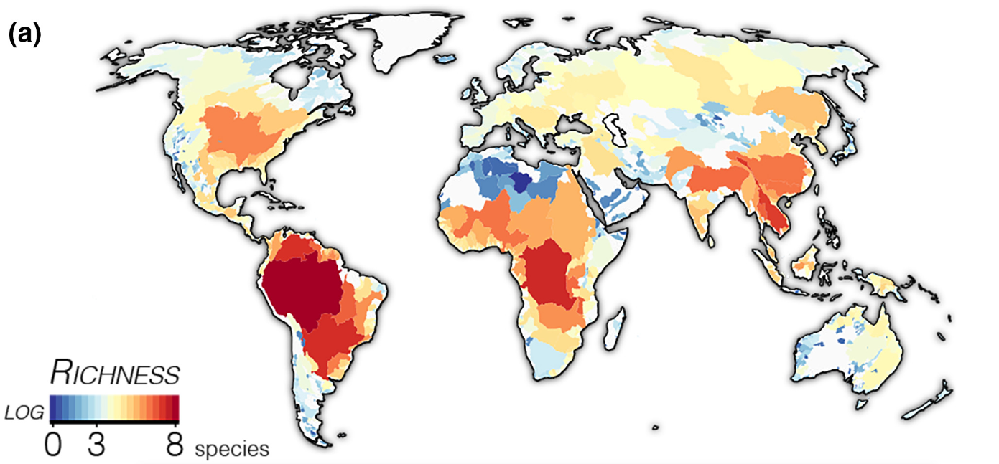
Species Richness: Freshwater Fish
Miller EC, Román-Palacios C. 2021

Slide 5
Latitudinal Diversity Gradient
Species diversity tends to diminish towards the poles
Can folks think of other groups with a similar latitudinal diversity gradient?

Slide 6
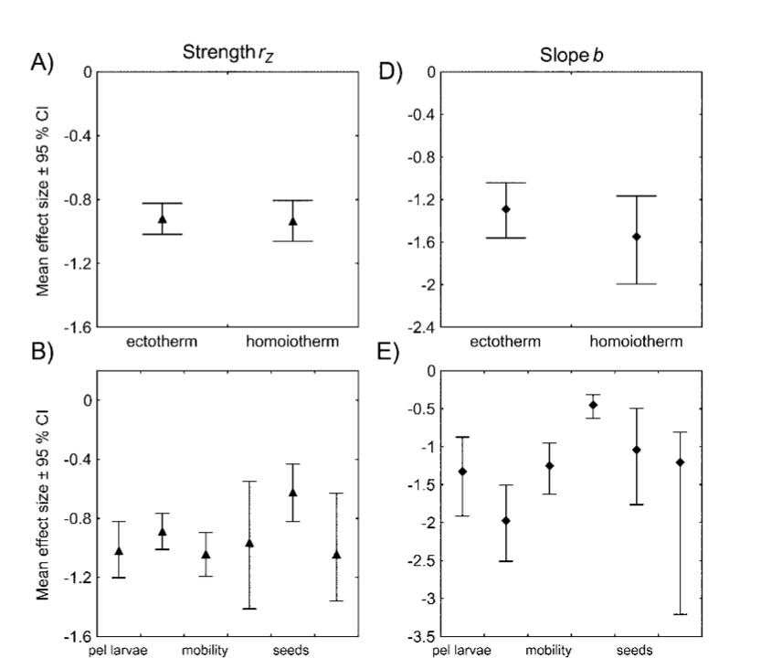
Latitudinal Diversity Gradient
Hillebrand 2004

Slide 7
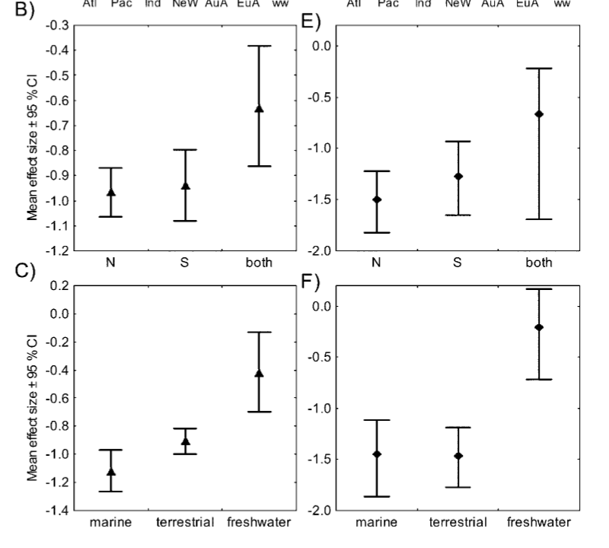
Latitudinal Diversity Gradient
Hillebrand 2004
Notes:
Relatively consistent

Slide 8
Latitudinal Diversity Gradient
Can anyone think of any counter-examples?

Slide 9
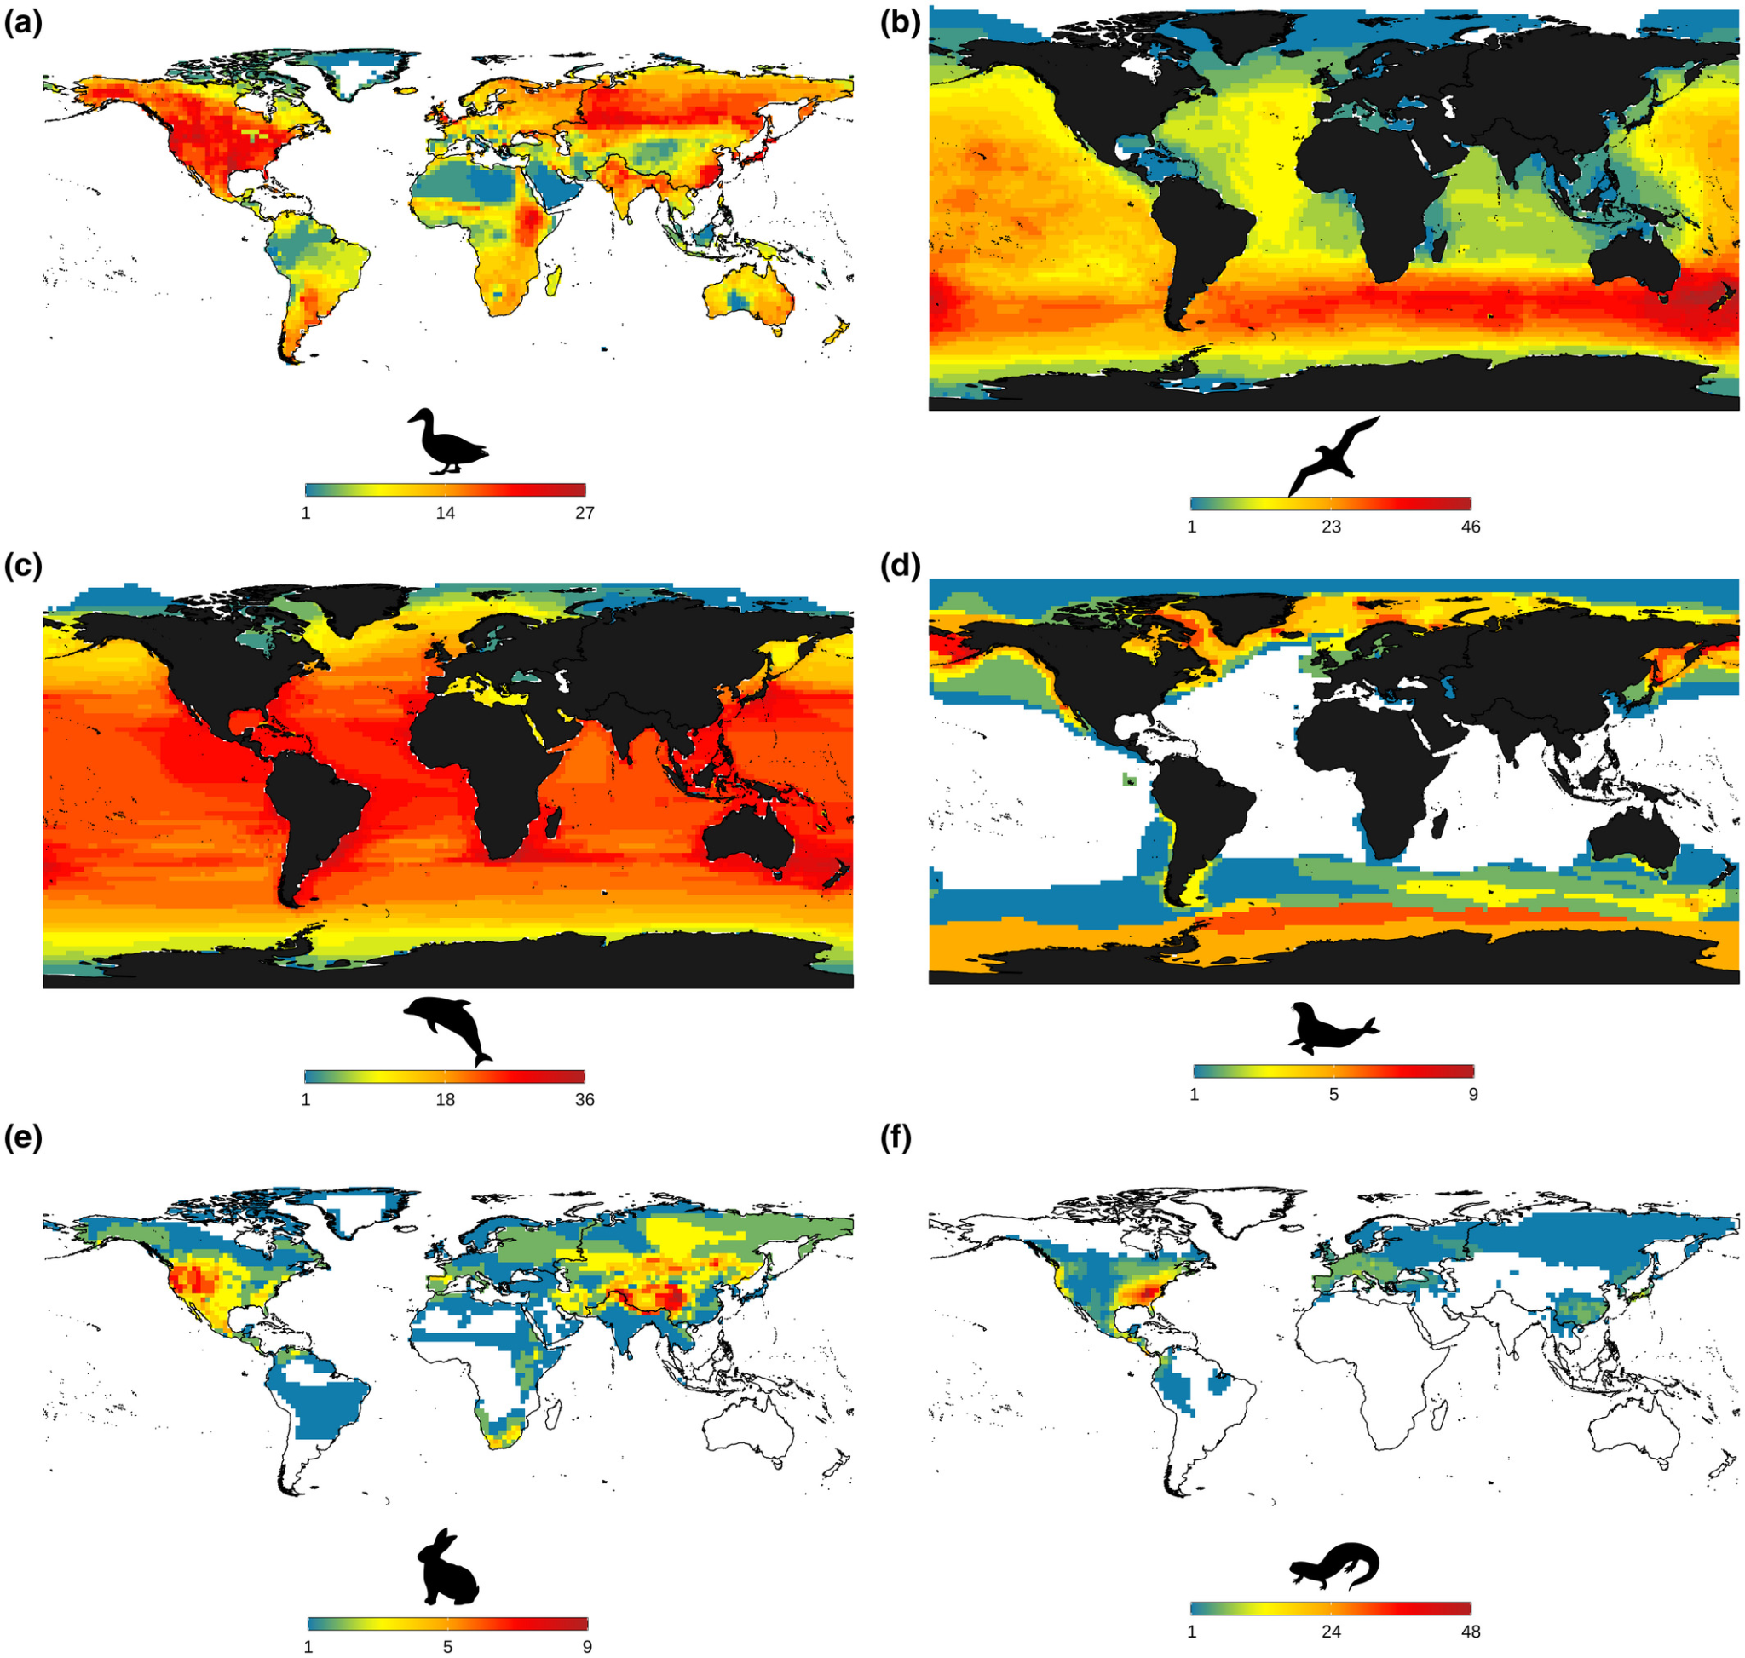
Exceptions to the Rule
Ducks and geese
Albatrosses and petrels
Whales and dolphins
Seals and sea lions
Rabbits and pikas
Salamanders and newts
Cerezer, F. O., Machac, A., Rangel, T. F., & Dambros, C. S. (2022)

Slide 10
Other Diversity Patterns?

Slide 11
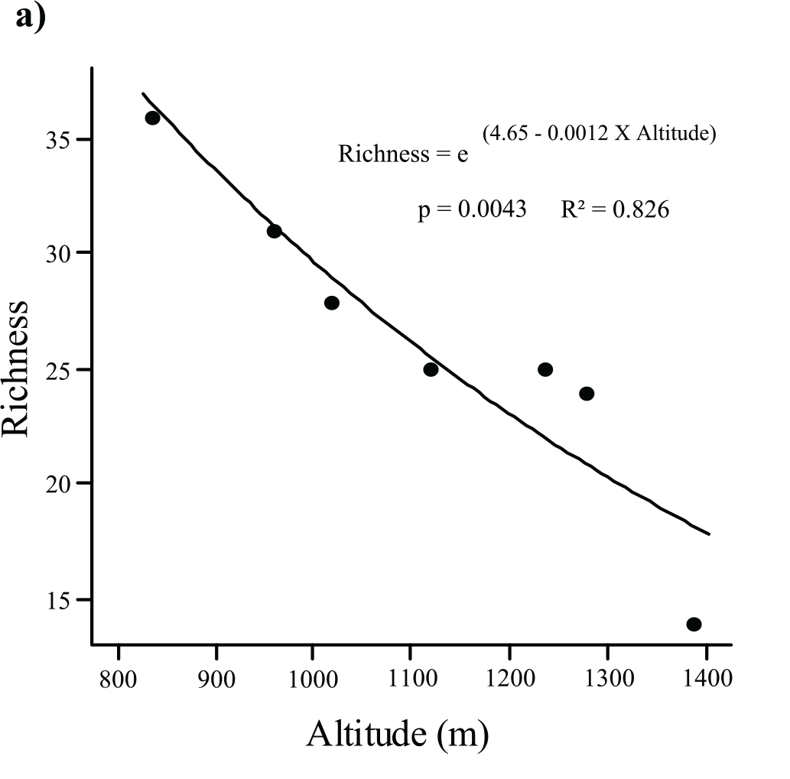
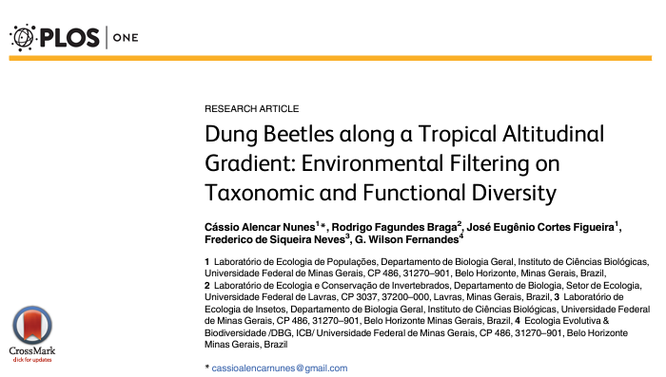
Altitude

Slide 12
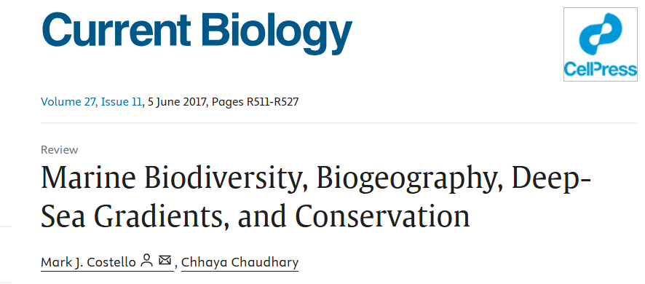
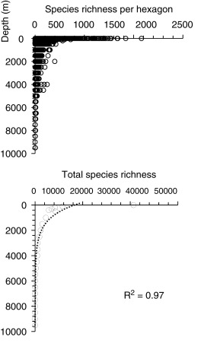
Ocean Depth

Slide 13
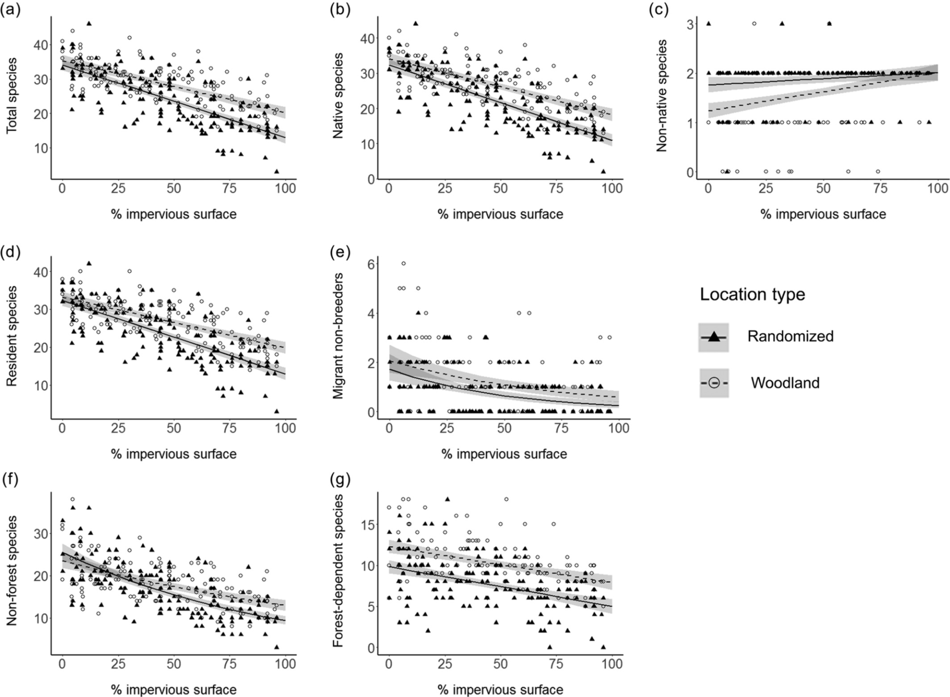
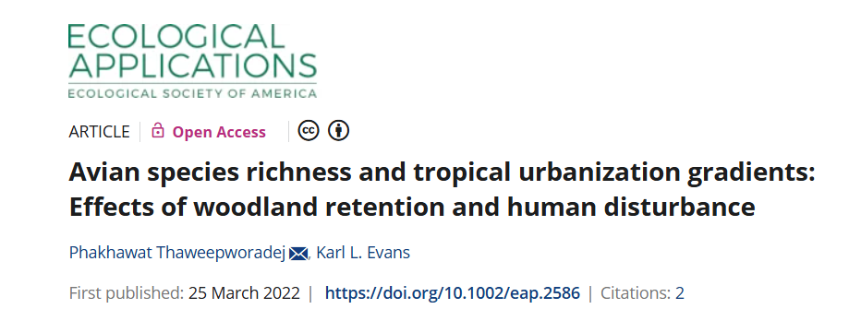
Urbanization

Slide 14
How to we measure diversity?

Slide 15
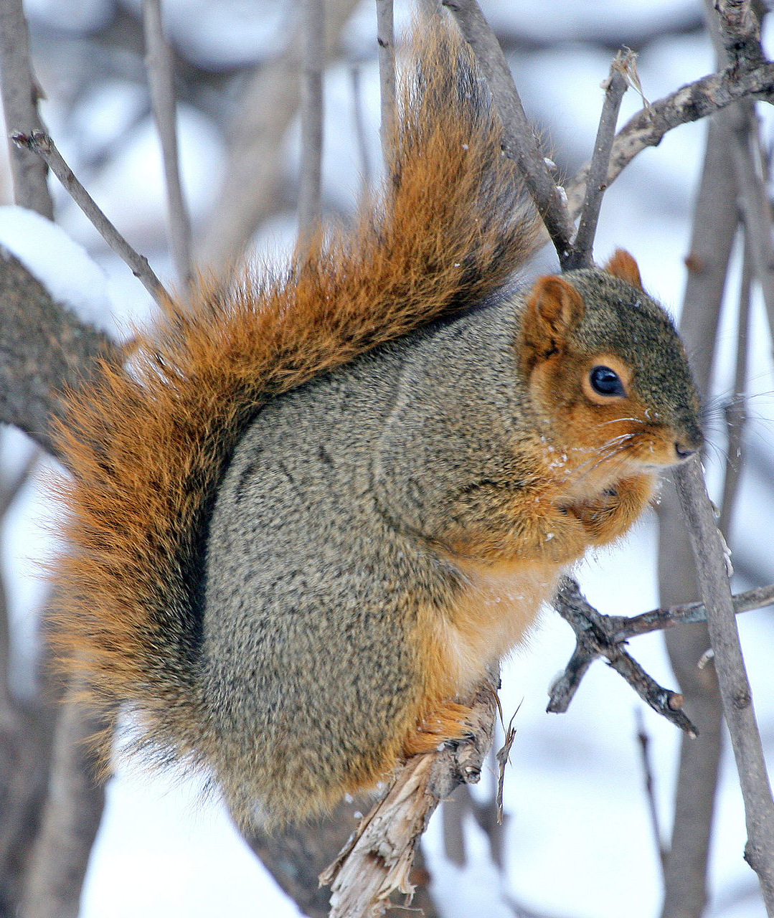
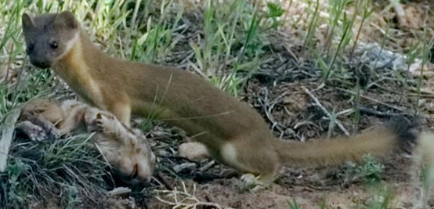
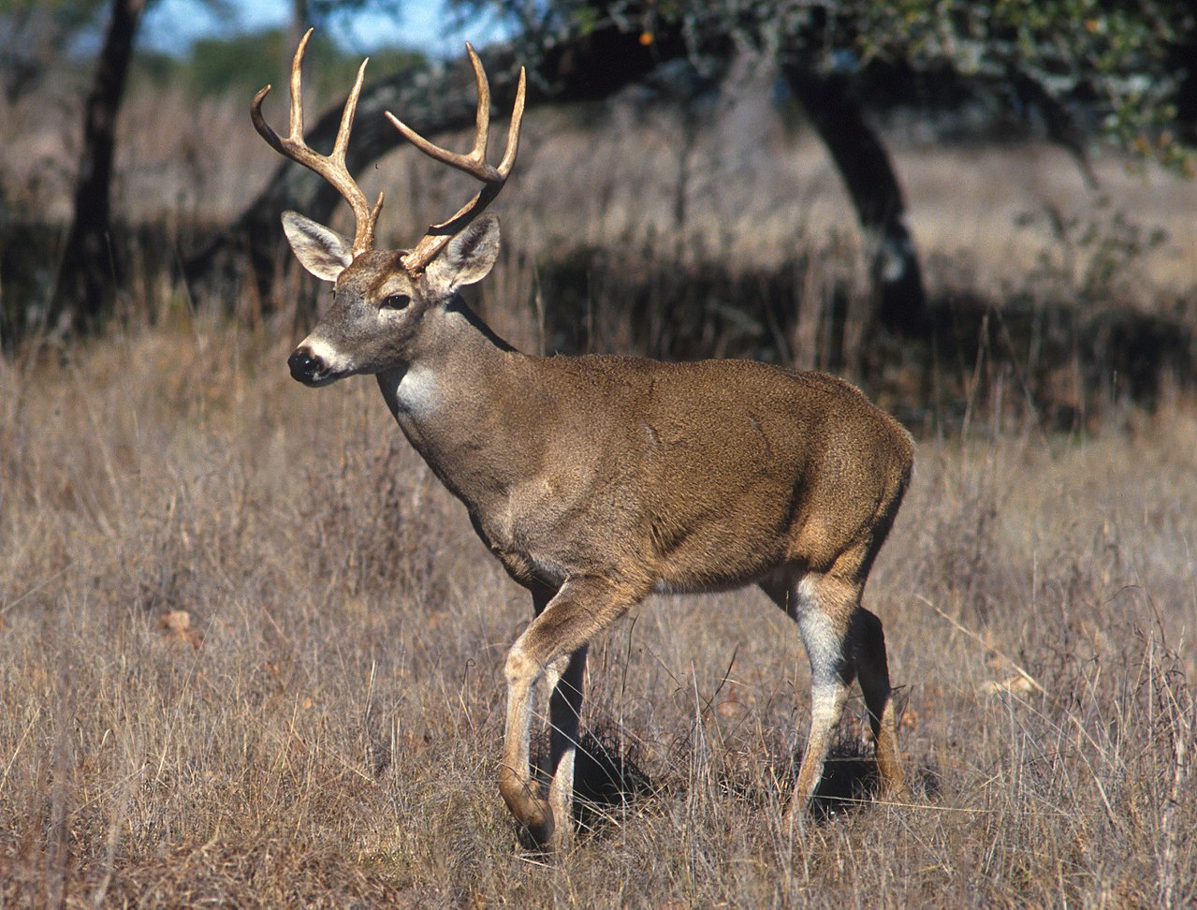
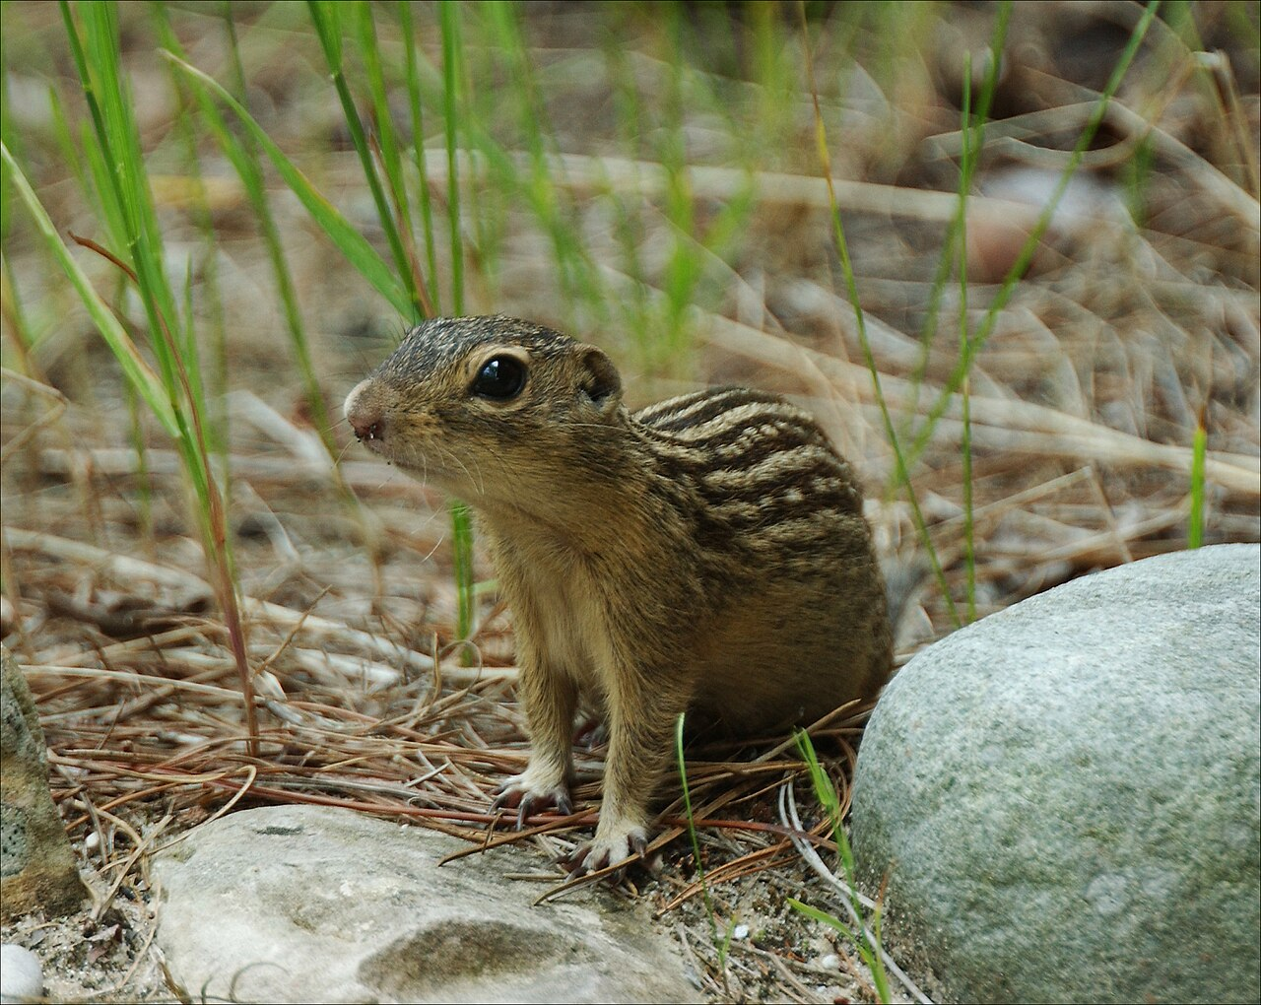
How to we measure diversity?
Species Richness

Slide 16
How to we measure diversity?
Species Richness = 4

Slide 17
Beyond Species Richness
Taxonomic diversity only tells you so much
Phylogenetic + functional

Slide 18
Phylogenetic Diversity

Slide 19
Phylogenetic Diversity
Community A
Community B
Notes:
Species richness = 4 v 3

Slide 20
Phylogenetic Diversity
Community A
Community B
Richness = 4
Richness = 3
Notes:
Species richness = 4 v 3

Slide 21
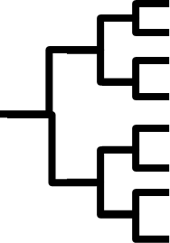
Phylogenetic Diversity
Community B
Time

Slide 22
Phylogenetic Diversity
Community B
Time

Slide 23
Phylogenetic Diversity
Community B
Time
Notes:
For this example, assume each branch (grey rectangle) is ~ 1 million years

Slide 24
Phylogenetic Diversity
Community B
Phy. Diversity ~ 8 million years
Time
Notes:
For this example, assume each branch (grey rectangle) is ~ 1 million years

Slide 25
Your turn!
Community A
Time

Slide 26
Your turn!
Community A
Phy. Diversity ~ 6 million years
Time

Slide 27
Phylogenetic Diversity
Community A
Community B
Richness = 4
Phy diversity = 6 million years
Richness = 3
Phy diversity = 8 million years
Notes:
Species richness = 4 v 3

Slide 28
… but why?
Why might measuring phylogenetic diversity be useful?
Discuss with those around you and then we’ll compare ideas

Slide 29
Why Phylogenetic diversity?
As a proxy for traits
As a measure of irreplaceability

Slide 30
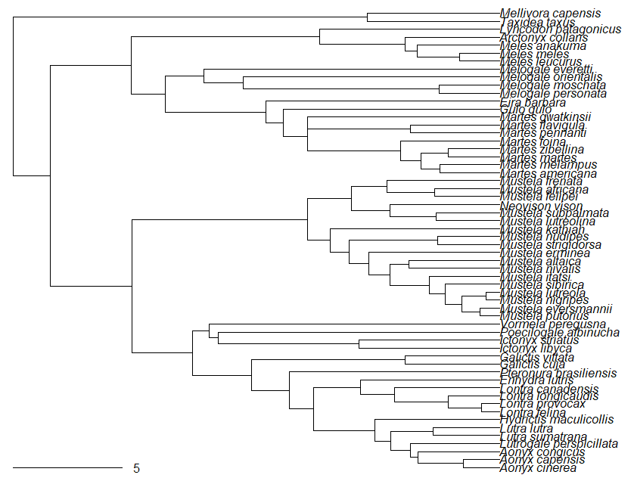
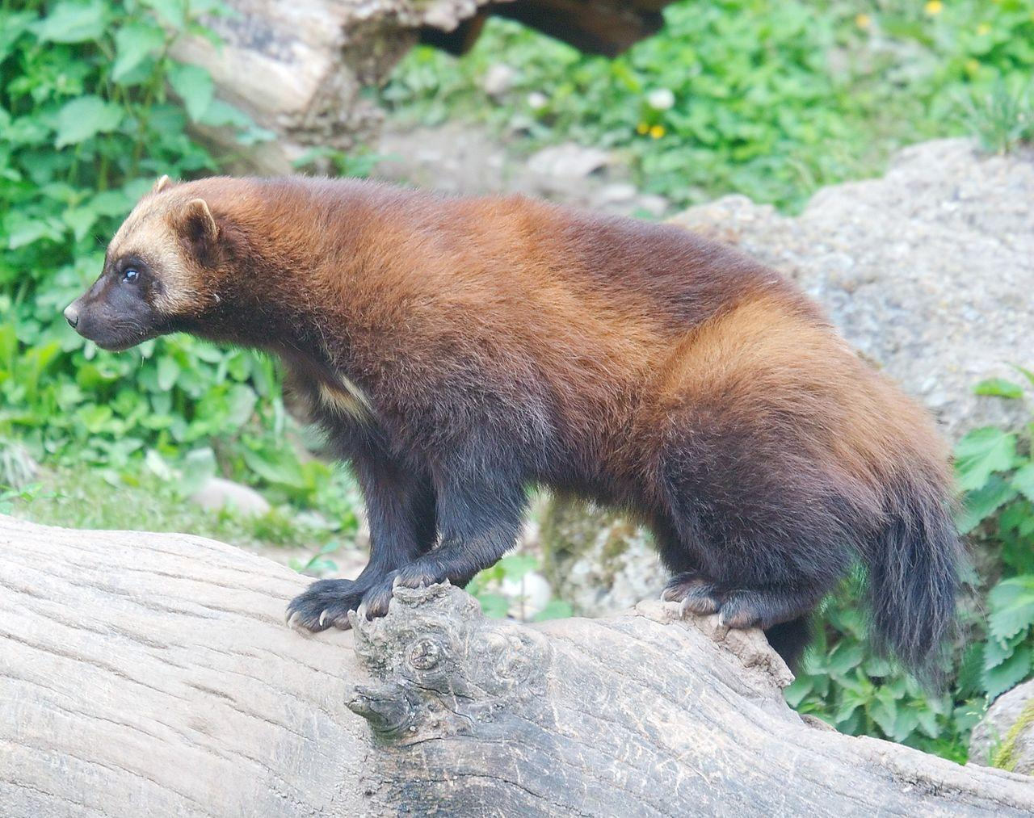
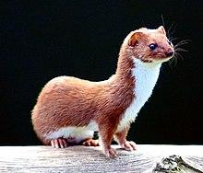
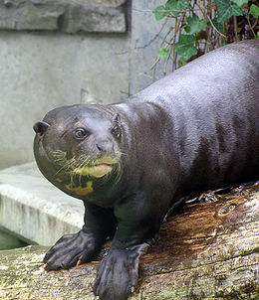
Example: Mustelids
CT Cooper
Matthias Kabel
Frank Wouters
Keven Law
5 Million Years
‹#›

Slide 31
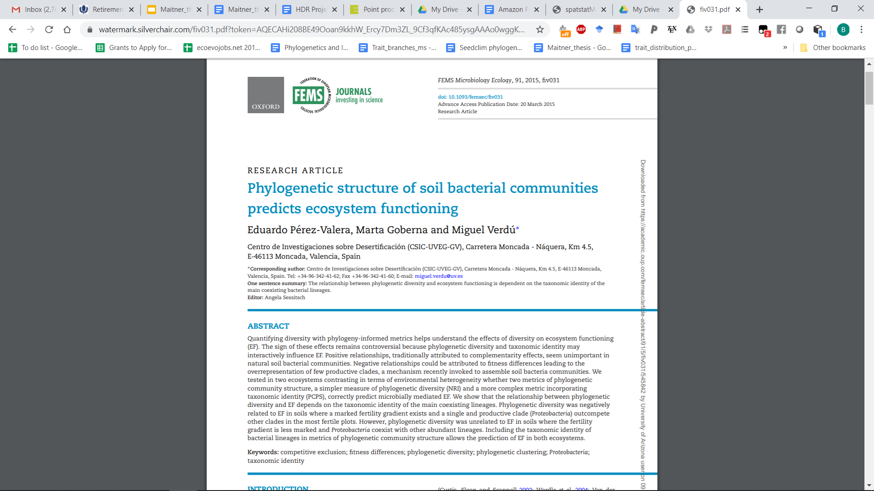
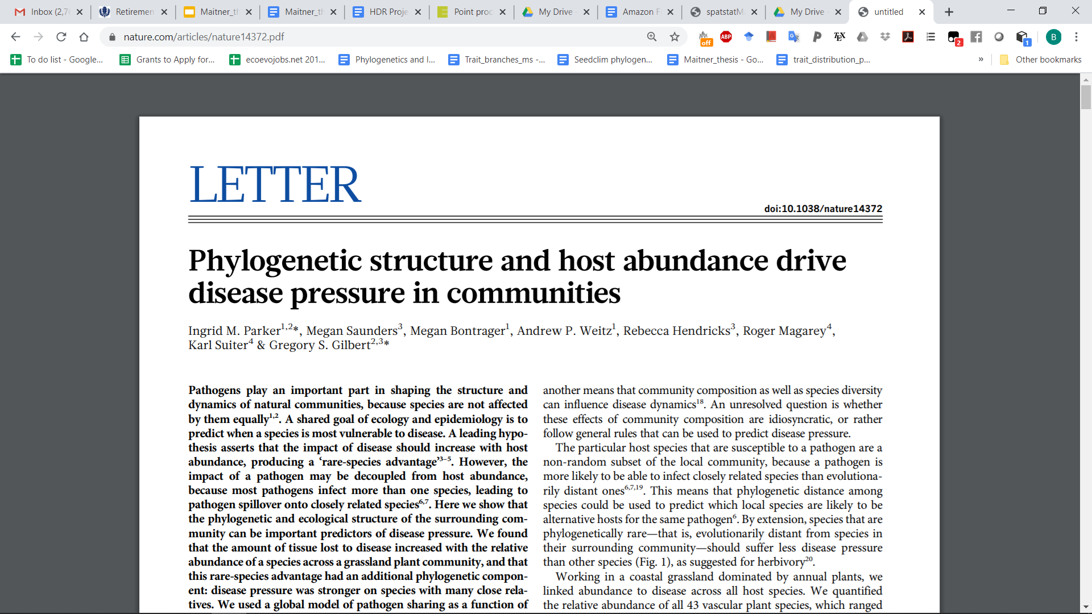
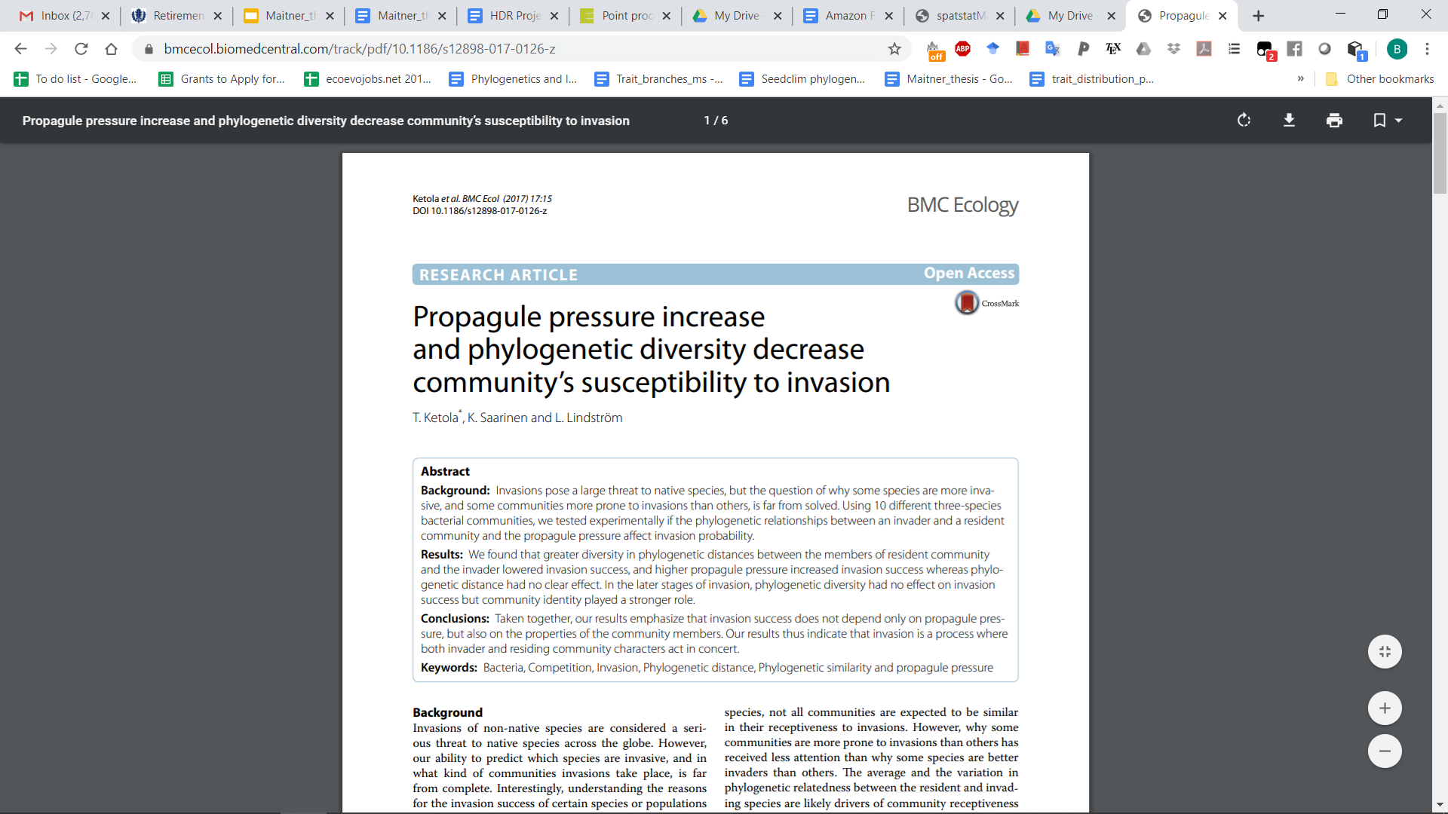
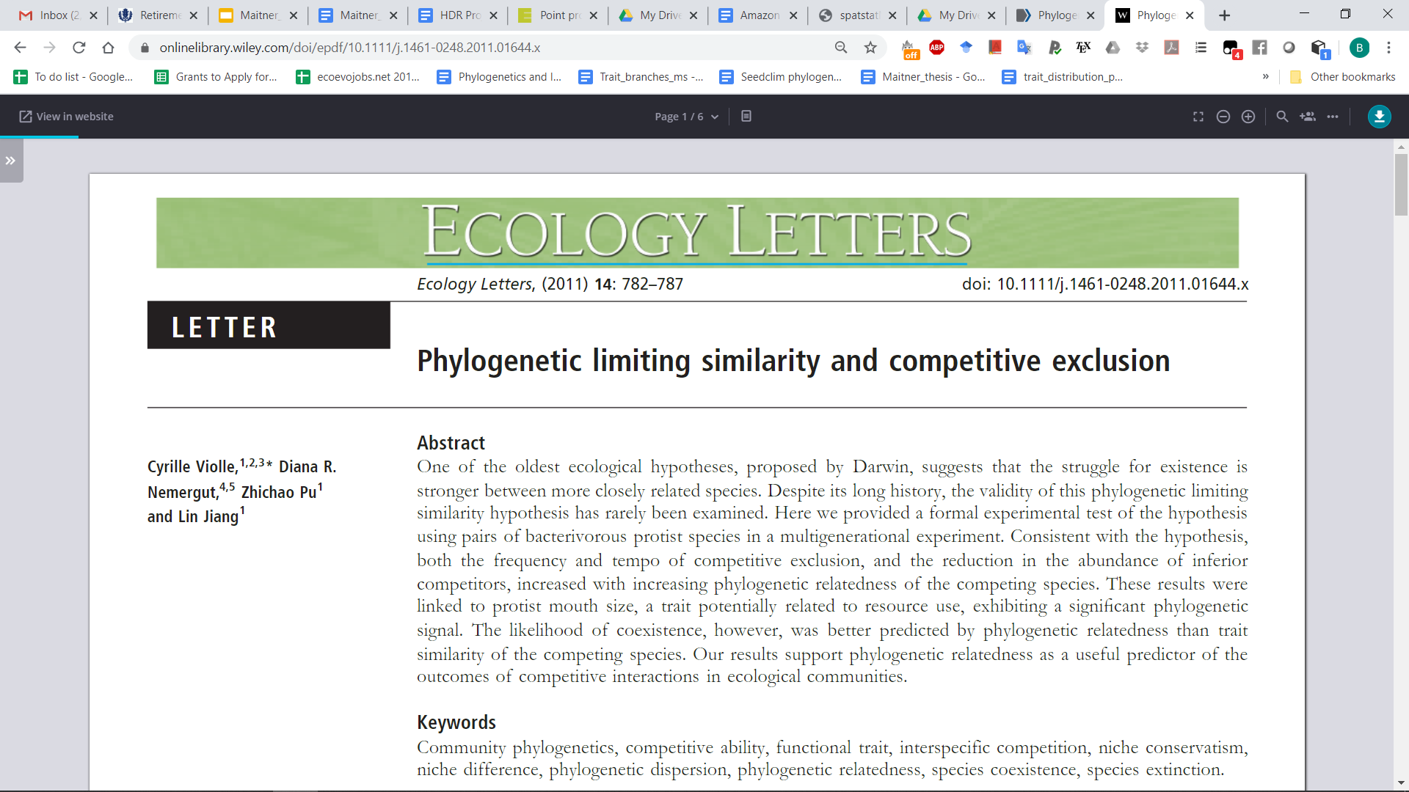
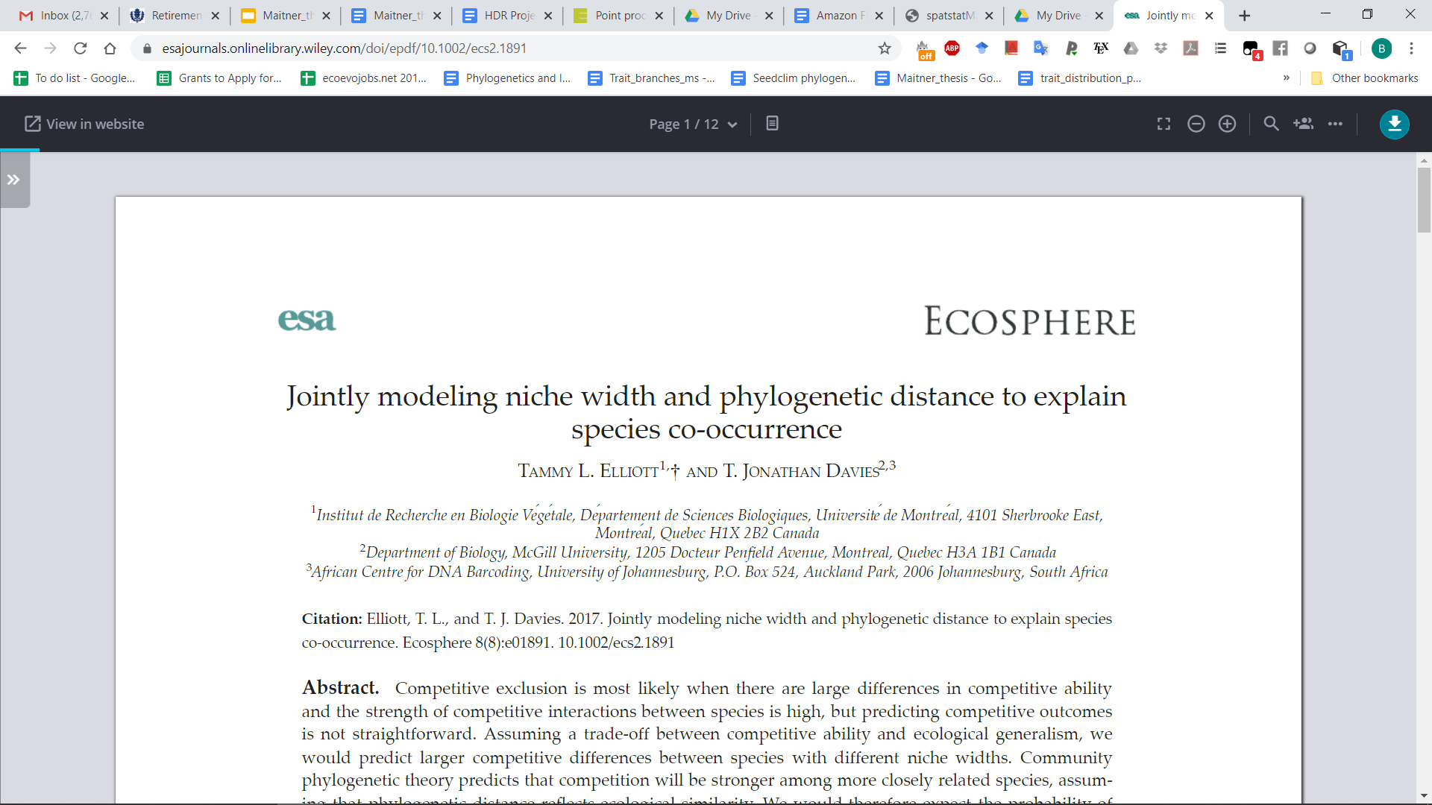
Why Phylogenetic diversity?

Slide 32
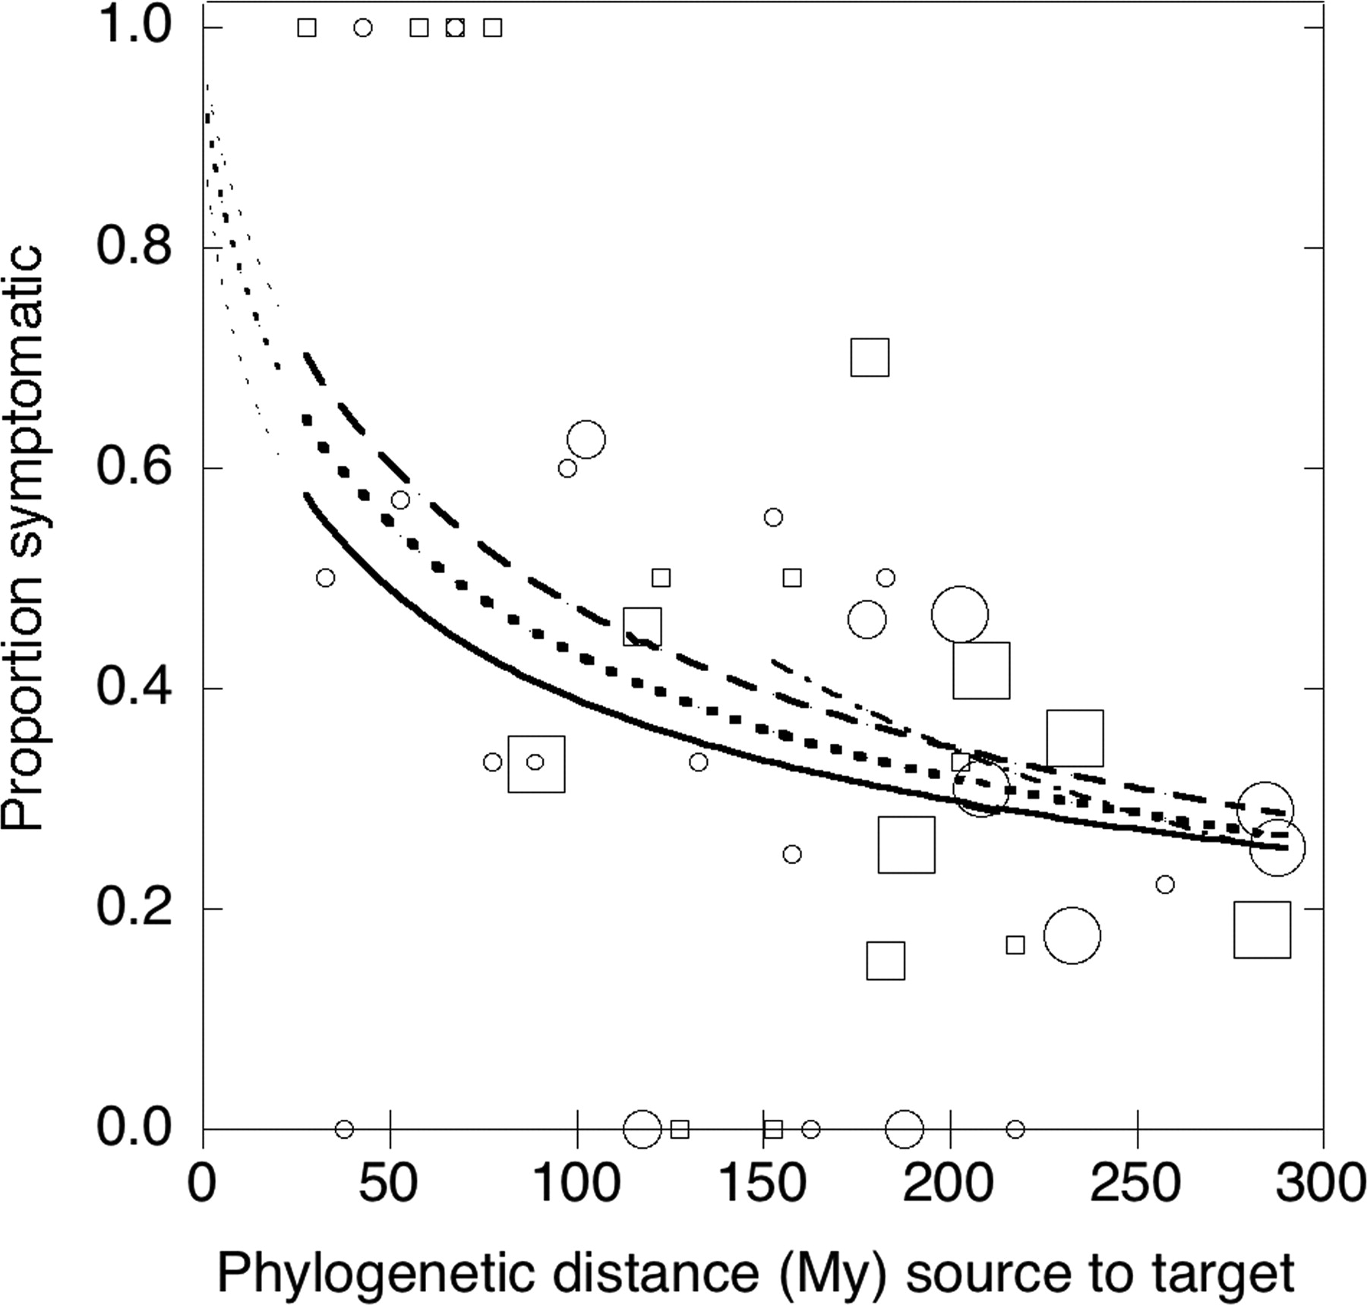
Phylogenetic Diversity
Very important for disease
G.S. Gilbert, C.O. Webb, Phylogenetic signal in plant pathogen–host range, Proc. Natl. Acad. Sci. U.S.A. 104 (12) 4979-4983

Slide 33
Phylogenetic diversity
Usually relies on assumptions about evolutionary distance and traits
Why not just measure the traits?

Slide 34
Functional Diversity

Slide 35
Functional Diversity
Focuses on measurable attributes
“Functional” refers to linkages between traits and processes
(we’ll talk more about this in later chapters)

Slide 36
Functional Diversity
Focuses on measurable attributes
“Functional” refers to linkages between traits and processes
(we’ll talk more about this in later chapters)
Examples:
Leaf area
Body size
Lifespan
Clutch size
Snout-vent length
Ploidy level
CT max / CT min

Slide 37
Functional Diversity
Are any of you measuring any “functional” traits?
If so what and why?

Slide 38
Measuring functional diversity
Multiple approaches
Probably the most common is the n-dimensional hypervolume approach

Slide 39
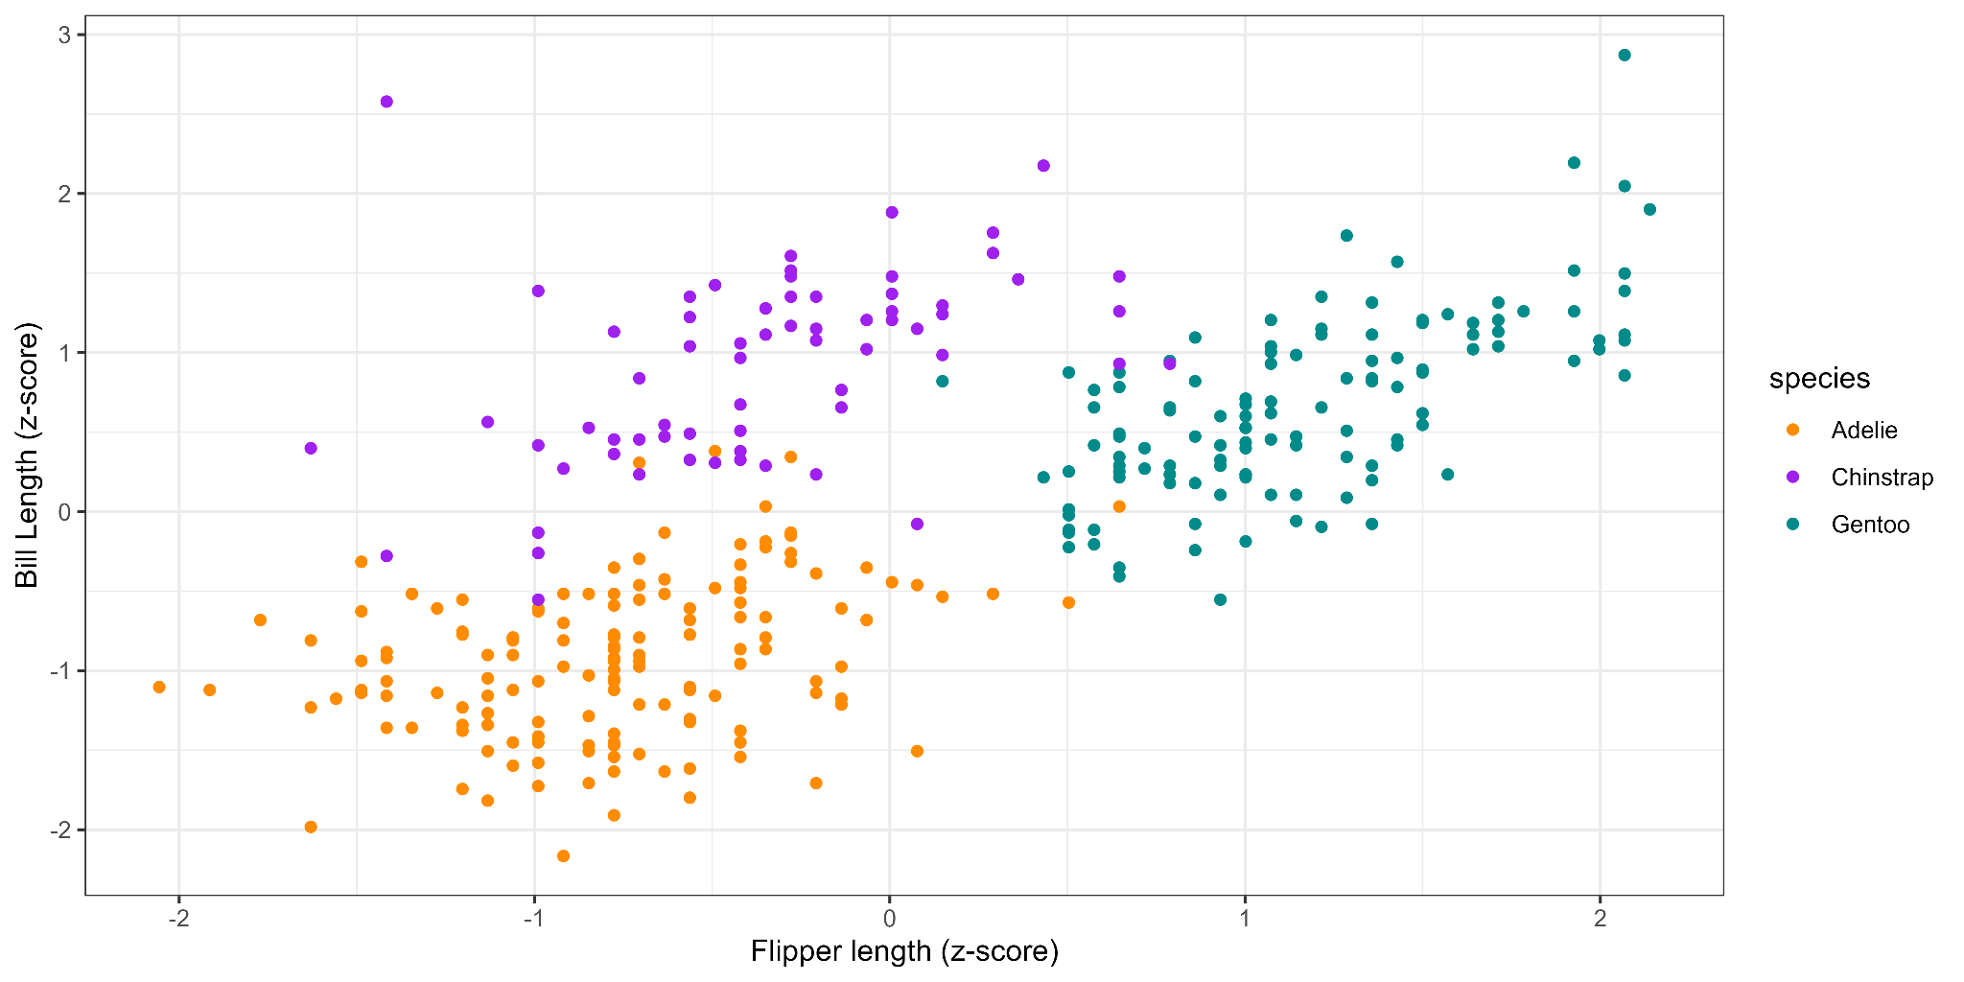
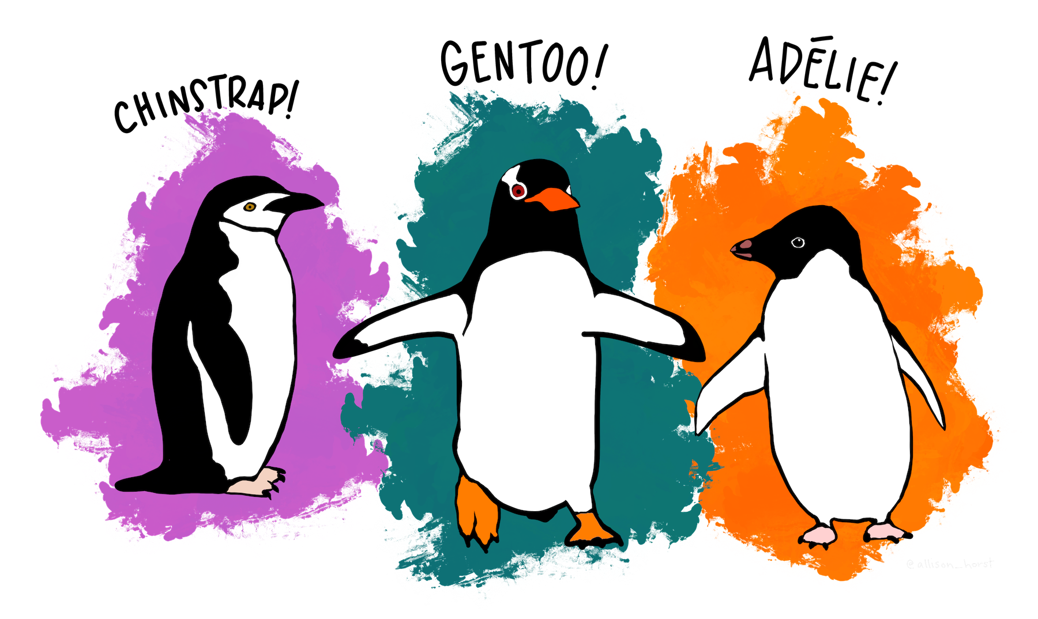
Measuring functional diversity
Example in 2 dimensions
Horst AM, Hill AP, Gorman KB (2020). palmerpenguins: Palmer Archipelago (Antarctica) penguin data. R package version 0.1.0.
Artwork by @allison_horst

Slide 40
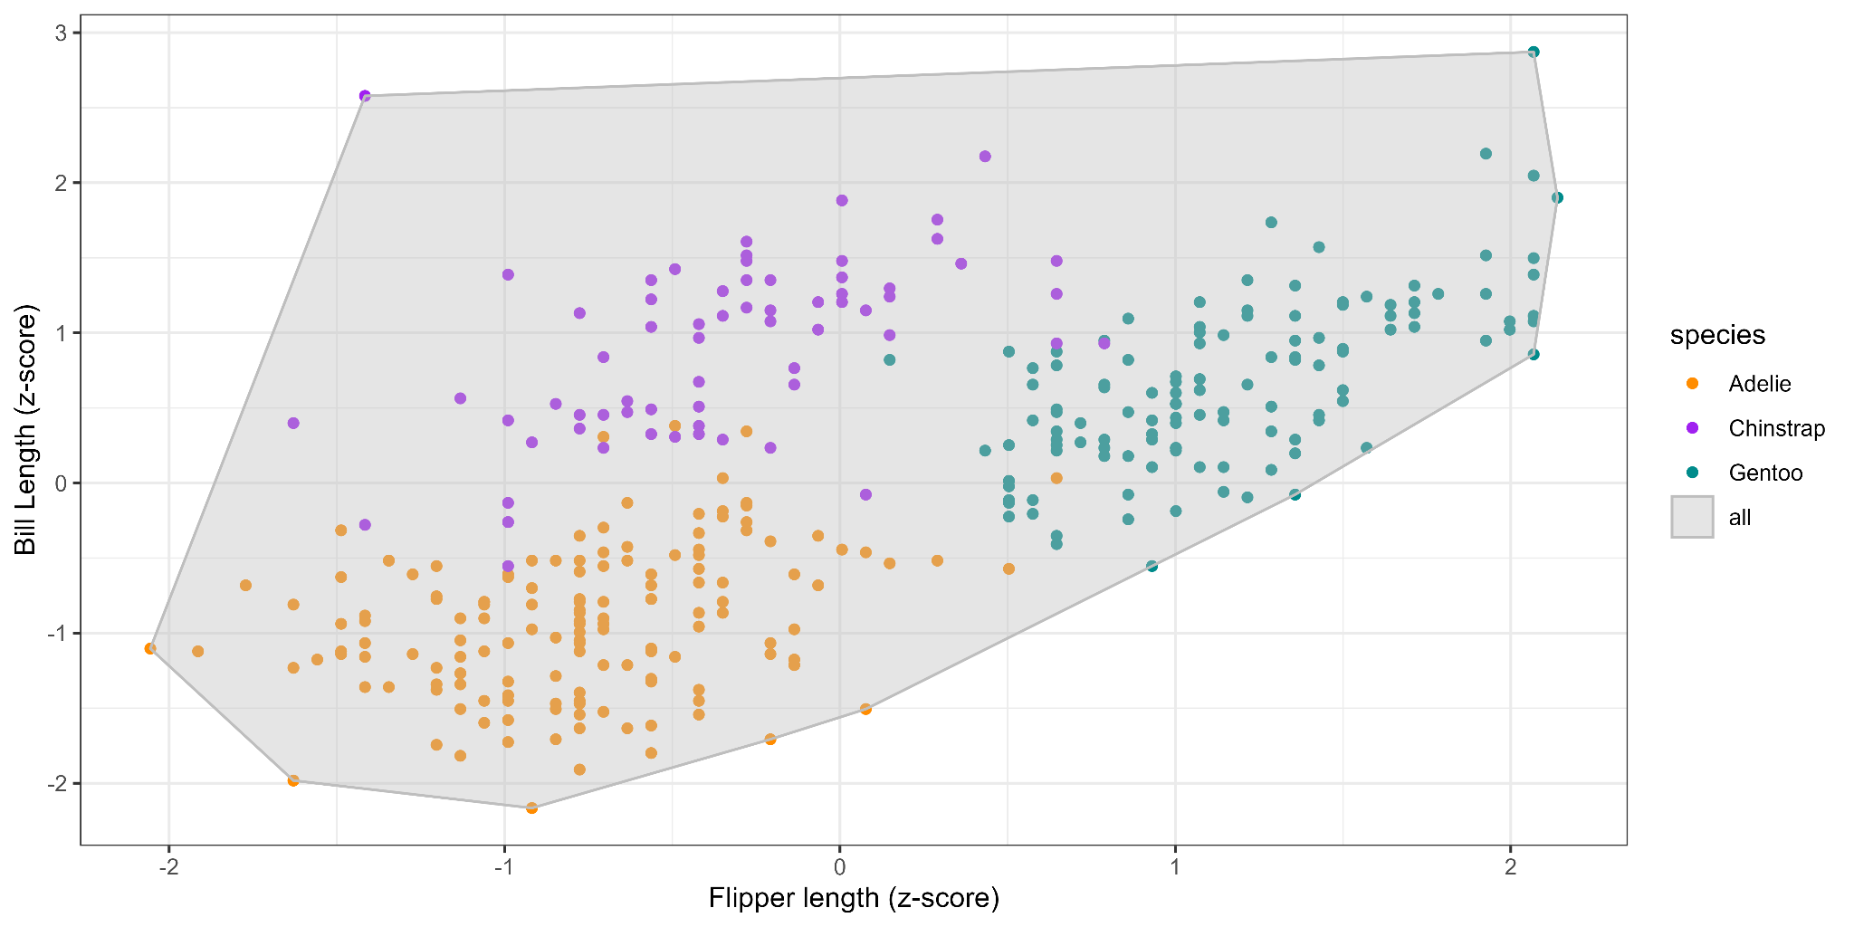
Measuring functional diversity
Community-level diversity
Horst AM, Hill AP, Gorman KB (2020). palmerpenguins: Palmer Archipelago (Antarctica) penguin data. R package version 0.1.0.
Artwork by @allison_horst

Slide 41
Measuring functional diversity
Community-level diversity
14.7
Horst AM, Hill AP, Gorman KB (2020). palmerpenguins: Palmer Archipelago (Antarctica) penguin data. R package version 0.1.0.
Artwork by @allison_horst

Slide 42
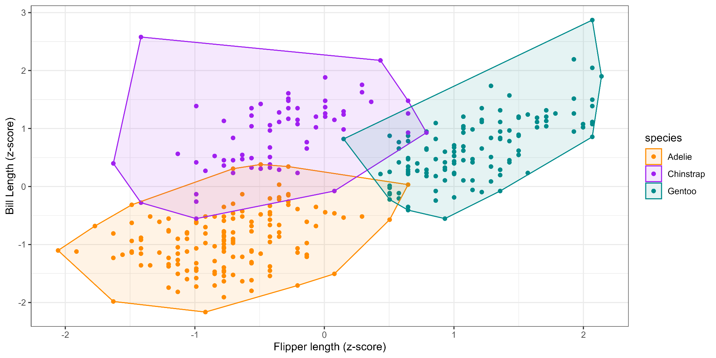
Measuring functional diversity
Intraspecific diversity
Horst AM, Hill AP, Gorman KB (2020). palmerpenguins: Palmer Archipelago (Antarctica) penguin data. R package version 0.1.0.
Artwork by @allison_horst

Slide 43
Measuring functional diversity
Intraspecific diversity
5.47
3.55
4.37
Horst AM, Hill AP, Gorman KB (2020). palmerpenguins: Palmer Archipelago (Antarctica) penguin data. R package version 0.1.0.
Artwork by @allison_horst

Slide 44
Measuring functional diversity
Sensitive to which traits are included
Need to think about which traits are relevant
Will discuss more later in the semester

Slide 45
Types of diversity
We’ve discussed different ways to measure diversity (e.g., function)
There are also different TYPES of diversity: alpha, beta, gamma

Slide 46
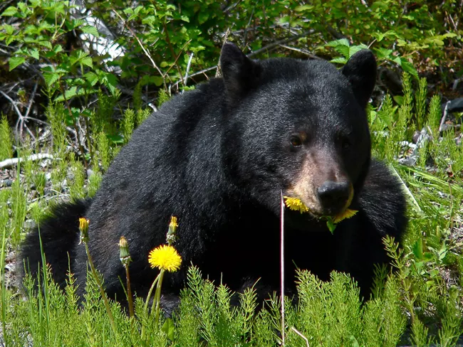
Types of diversity: alpha
α-diversity: local scale, n = 2

Slide 47
Types of diversity: gamma
𝛾-diversity: regional scale
n = 5

Slide 48
Types of diversity: beta
𝛽-diversity:
It varies
Measure of turnover
𝛽 = 𝛾 / 𝛼
𝛽 = 𝛾 - 𝛼
Measures of distance
etc.

Slide 49
Types of diversity: beta
𝛽-diversity:
It varies
Measure of turnover
𝛽 = 𝛾 / 𝛼
𝛽 = 𝛾 - 𝛼
Measures of distance
etc.
5 / 2 = 2.5
5 / 4= 1.25
5 / 2 = 2.5
5 / 3= 1.7

Slide 50
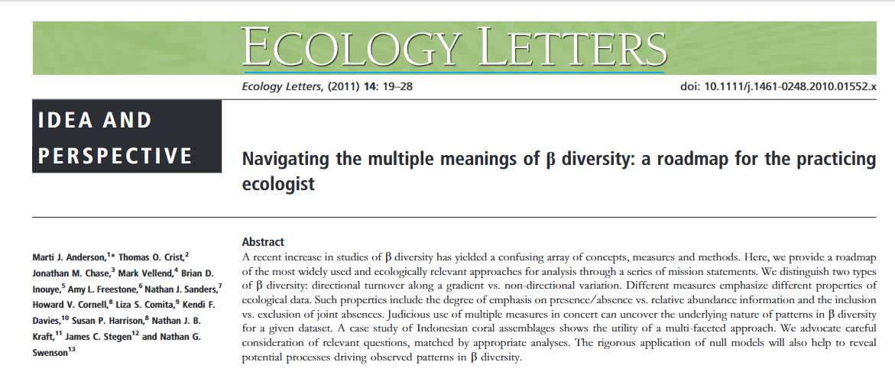
Types of diversity: beta
Dozens of ways of measuring beta diversity
See Anderson et al. for more details
In practice, focus on what makes sense for your questions

Slide 51
Types of diversity across other measurements
alpha, beta, and gamma metrics for functional and phylogenetic diversity
beta diversity is the most variable in terms of approaches

Slide 52
Other types of diversity patterns
Increasing efforts studying phylogenetic and functional patterns
Studying multiple types of diversity can be useful

Slide 53
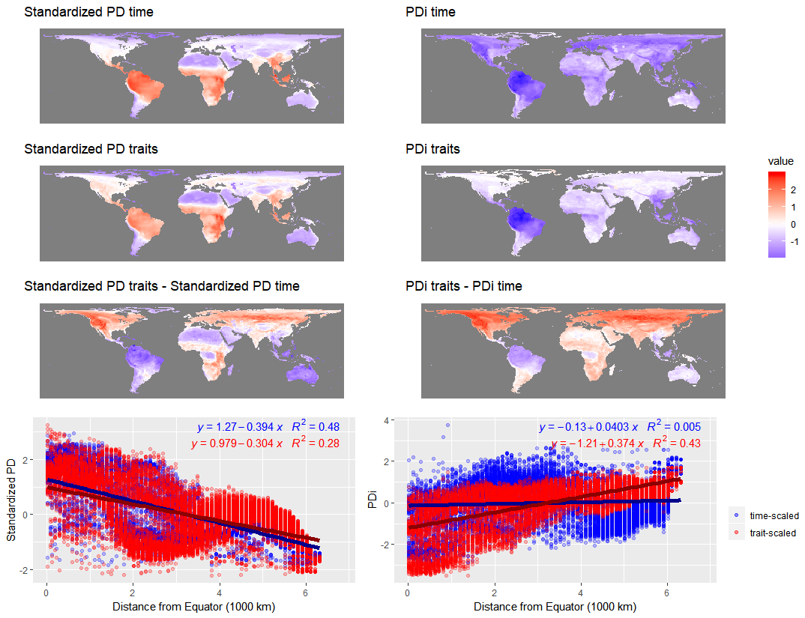
Mammal Phylogenetic Diversity
z-score

Slide 54
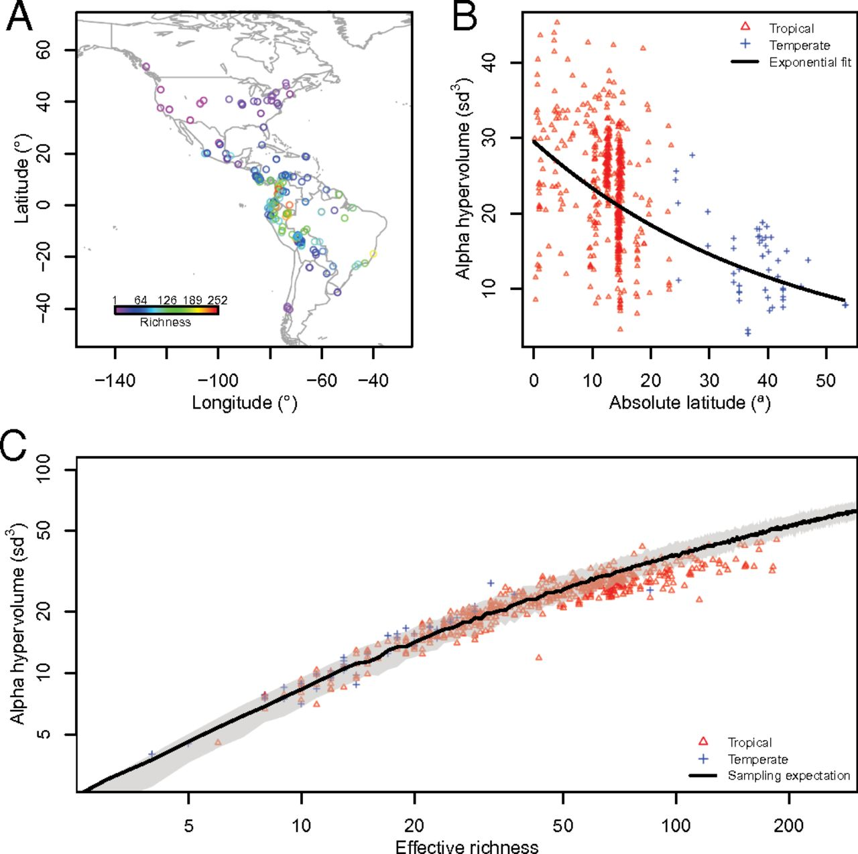
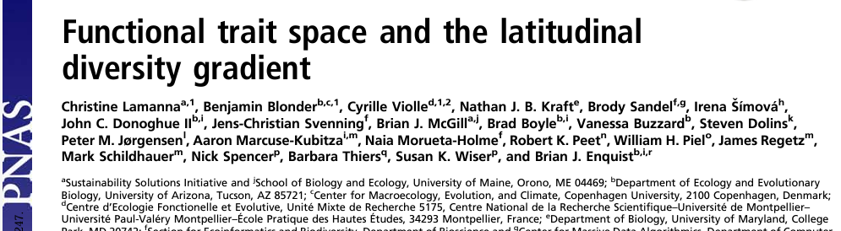
Plant Functional Diversity

Slide 55
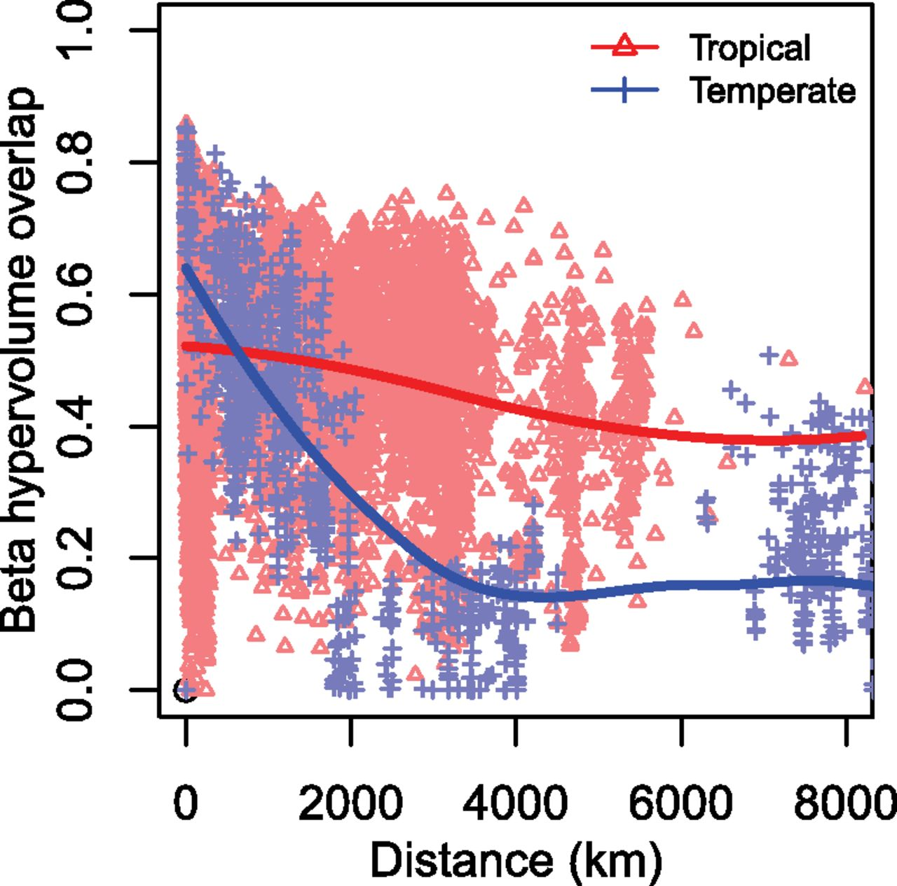
Plant Functional Diversity

Slide 56
Next class: SADs and SARs

